Slide 1
Immersive Technologies and 3D User Interfaces
September 05: Introduction and Course Elements Part 1

Slide 2
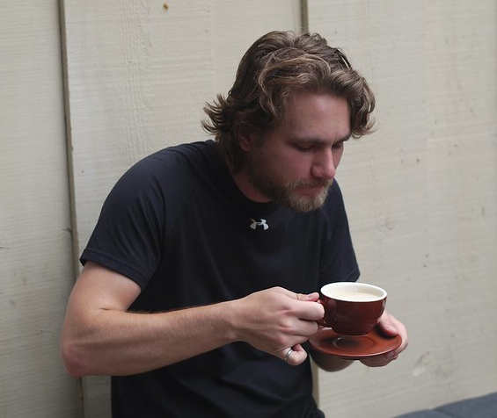
Who am I?
Jerald Thomas
He/Him/His
Call me Jerald
New Faculty
Defended Ph.D. in Dec. 2021
Postdoc from Jan. 2022 to May 2023
Researches perception and interaction in VR/AR
Also likes:
Reading
Camping
Rock climbing
Woodworking
Coffee

Slide 3
After this course, you will understand…
… how virtual reality technologies, software, and systems work
… how to develop virtual reality applications and 3D user interfaces
… how to implement common spatial interaction techniques
… how to critically evaluate what makes a virtual reality experience effective and compelling
and what doesn’t

Slide 4
What you won’t learn in this course?
How to create art assets (3D models, textures, etc.)
How to design narrative content for video games
How to physically construct or reverse engineer virtual reality devices

Slide 5
To succeed in this course, you should be…
… self-motivated
… interested in thinking critically about virtual reality
… willing to commit sufficient time
Familiarity with computer graphics or game engines is beneficial, but not required
Notes:
Sufficient time:
9 hours / week for an “average” student to get a C
Closer to 12 for a grad student

Slide 6
How to navigate Canvas and the syllabus

Slide 7
Class Structure
Some days will be traditional lecture
Some days will be live programming and demonstration
I am new to this, please be flexible

Slide 8
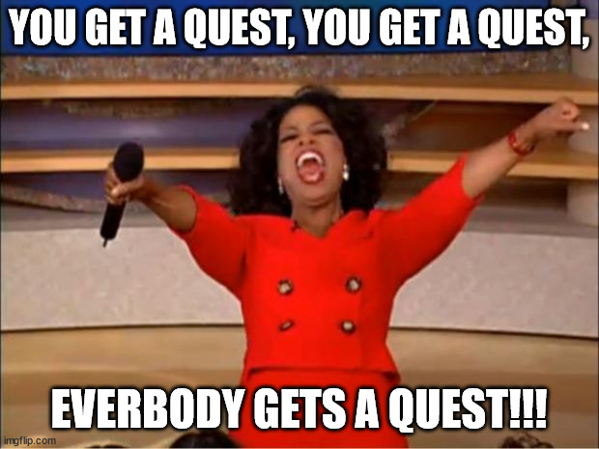
VR Equipment
Each student will get a Meta Quest 2 for the duration of the semester

Slide 9
Meta Quest 2
Devices will be checked out from the Library Equipment and Reserve Services
You should have received an email with instructions (let me know if you didn’t)
You are free to use your own if you have one
A Meta account is required (does not need to be linked to a Facebook account)
You must use the Quest app on your phone for initial setup
Each controller uses on AA battery
You are responsible for providing the batteries
Having back-up batteries is strongly suggested
Notes:
Get yours as soon as possible to set it up and start playing with it. Try beatsaber.

Slide 10
VR Headset Sanitization
A UV sanitization cabinet is currently in the process of being ordered
Will be housed here at CSI
More details when it arrives
Please keep (or install) the silicone face foam covers on the device
Allows for easy cleaning
Helps the device last longer
Don’t use any cleaning agent on the lenses

Slide 11
Textbook
The textbook for this class is for reference purposes
It is not strictly required, but highly recommended
3D User Interfaces: Theory and Practice (Second Edition)
LaViola, Kruijff, McMahan, Bowman, and Poupyrev. ISBN: 978-0134034324
Amazon Link: https://www.amazon.com/3D-User-Interfaces-Practice-Usability/dp/0134034325

Slide 12
Unity3D
Game engine that we will use to create VR applications
Most common used game engine for creating games
Also check out Unreal Engine, Godot, Babylon3D
Also the most common tool we use for VR research
Install on personal computer
Use the “Personal License”
Maybe available on CSI Lab machines
More details to come
Must use version 2022.3.8f1 (LTS)

Slide 13
Grading (Undergraduate)
45% - Programming Assignments
Five assignments, each worth either 10 or 20 points
There might be bonus points available
35% - Final Project
Due at the end of the course
Acts as final summative assessment (there is no final exam)
More details later…
20% - Quizzes
Six quizzes, administered on Canvas
Acts as periodic assessments (there is no midterm exams)

Slide 14
Grading (Graduate)
30% - Programming Assignments
Six assignments, each worth either 10 or 20 points
There might be bonus points available
25% - Final Project
Due at the end of the course
Acts as final summative assessment (there is no final exam)
More details later…
20% - Quizzes
Six quizzes, administered on Canvas
Acts as periodic assessments (there is no midterm exams)
15% - Paper Presentation
Will happen at one of 4 “Journal Club” sessions
10% - Annotated Bibliography
Summarize 10 academic papers that you must read by the end of the semester

Slide 15
Office Hours
Time:
Monday 4:00-5:00
Wednesday 2:00-3:00
By appointment
Other office hours (lower priority):
Tuesday 4:00-5:00
Thursday 2:00-3:00
Topics:
Just saying “Hi”, talking about school, research
Homework help
Recommendation letters
Questions about class, grade, etc.

Slide 16
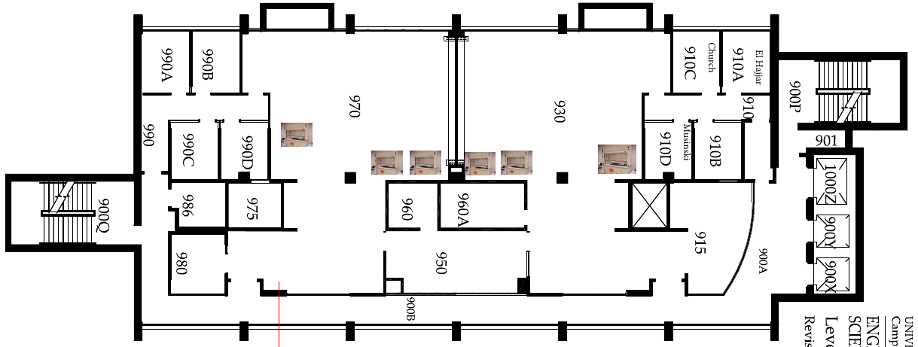
Office Hours

Slide 17
ChatGPT

Slide 18
Course Expectations
I expect that you will:
Attend lectures
Put in the effort to learn
Adhere to class and university policies
Ask for help when needed
What do you expect?

Slide 19
Questions?
More information about the course will be covered on Thursday

